Slide 1
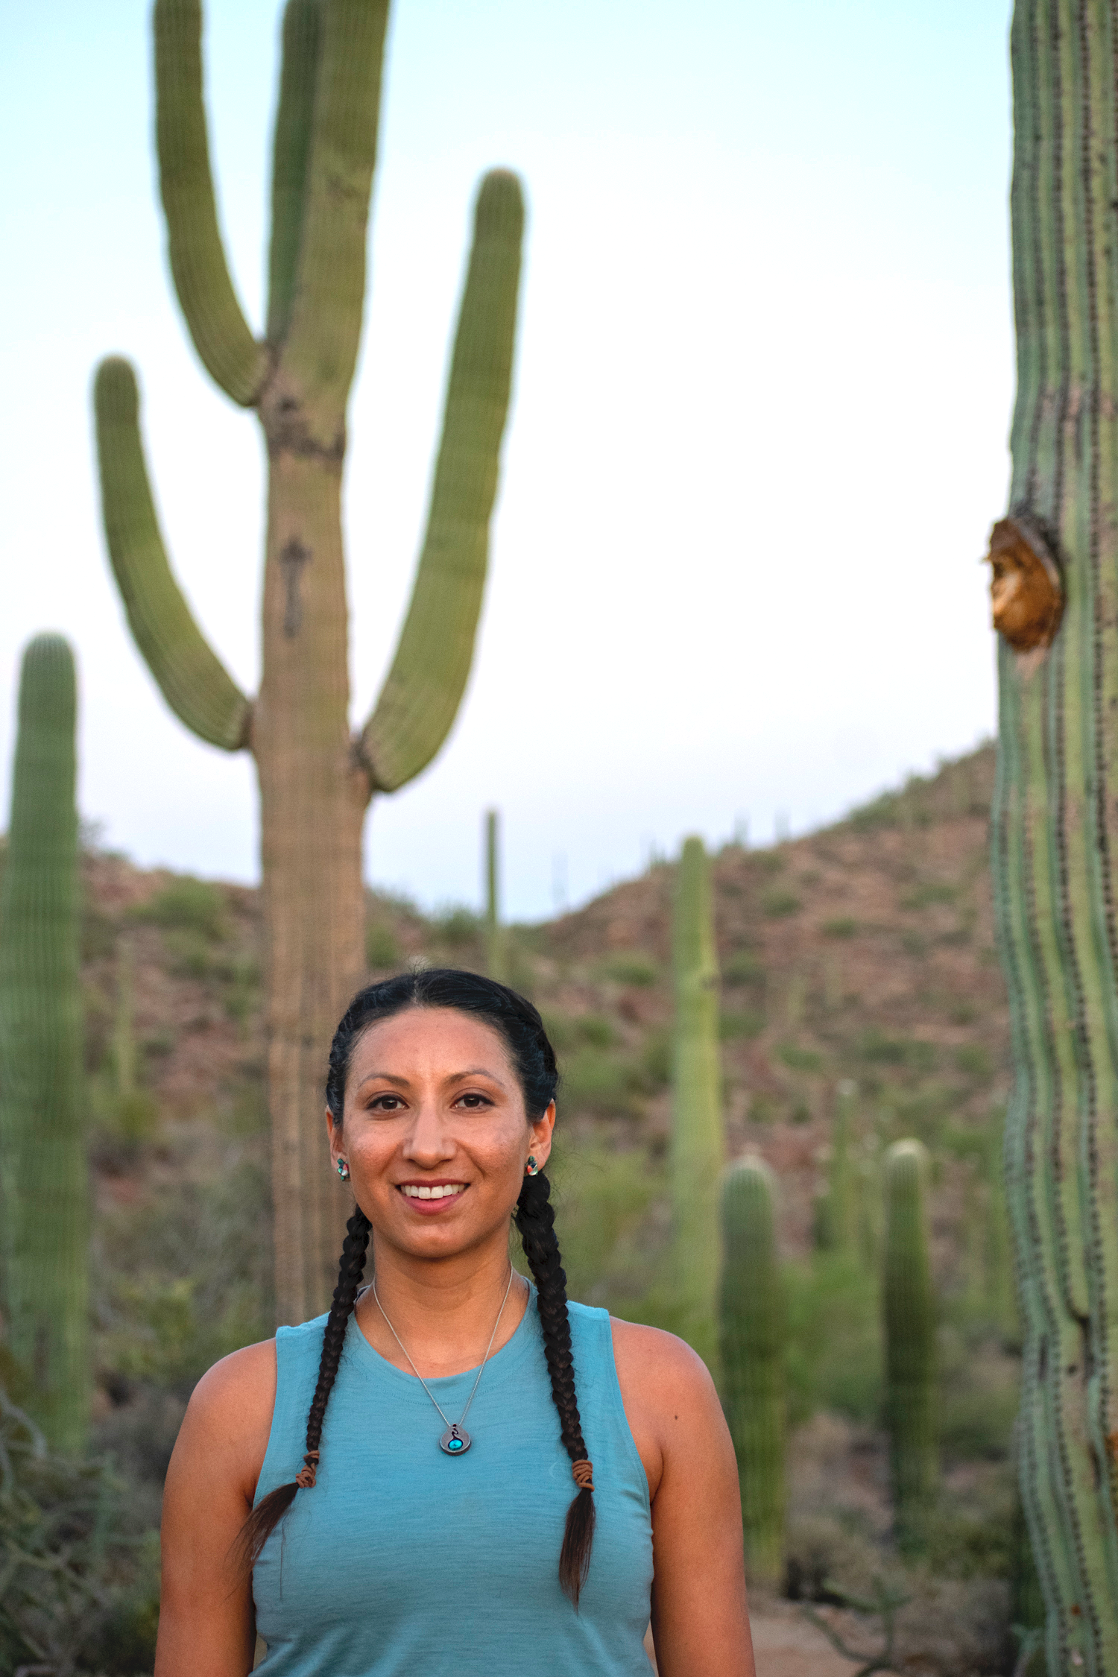
The Ethics of Data: Moving from Data “Wardship” to Data Sovereignty
Lydia Jennings, Ph.D.
Post Doctoral Researcher in Community, Environment & Policy.
Data Science Fellow, Data Science Institute.
University of Arizona
(Lands of the Tohono O’odham Nation & Pascua Yaqui Tribe)

Slide 2
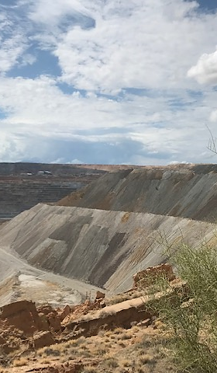
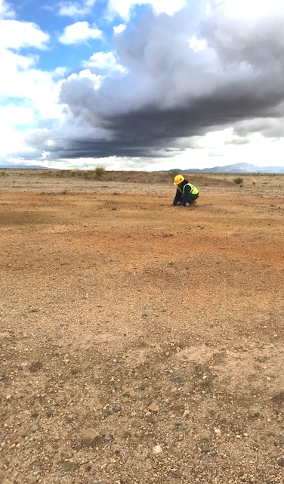
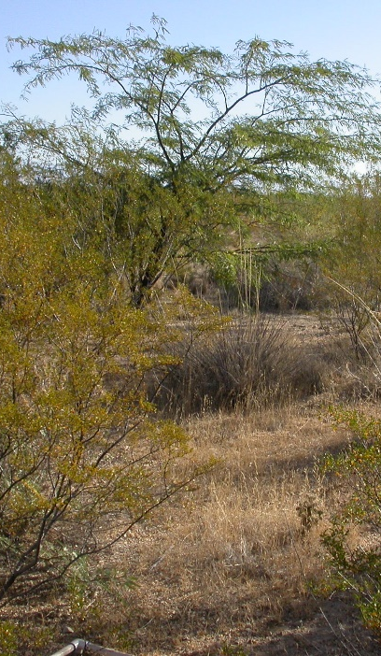
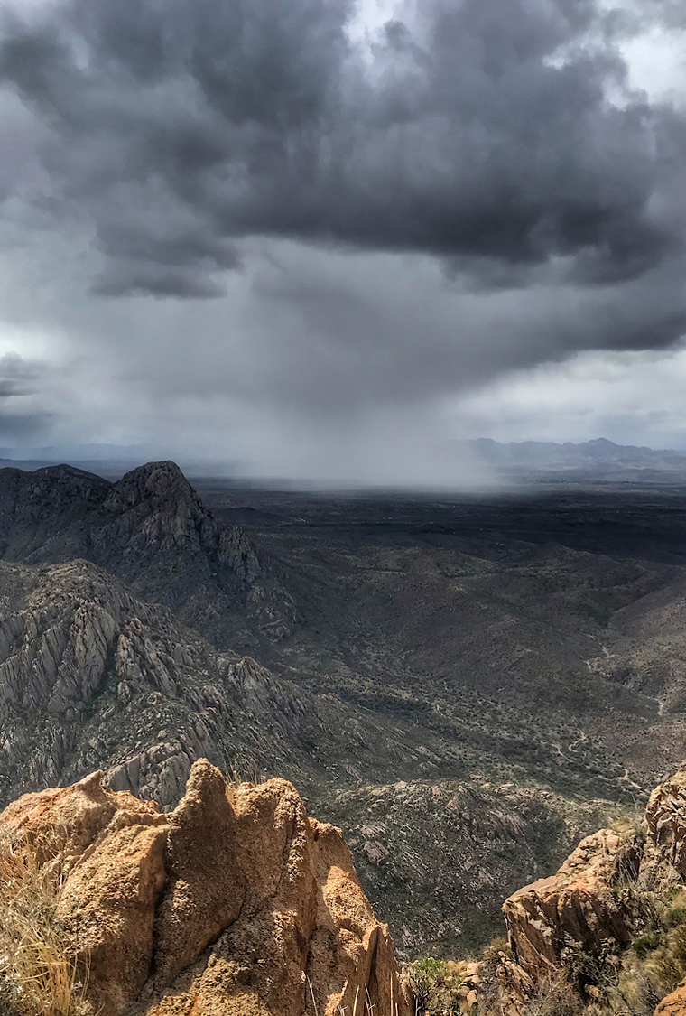
Notes:
My PhD work was in mining reclamation. In this research, I was interested in understanding how do we ecologically heal landscapes from mining. However in this process, I also became curious about what is happening from a policy side, that so many mines are happening on or bordering tribal nations? I spent a lot of time reading court cases and environmental impact statements to better understand environmental and cultural impacts of mining. As I read court cases and reports, I was really struck at how much cultural information was shared in these documents– cultural information that my own tribal leadership didn’t know or was uncomrdtable sharing, and reflected on how tribal nations are often put in a position to share a signifigant amount of cultural information in order to protect sacred ecosystems. As many of our science communities are pushing for open science, I becamse really interested in how that cultural information is protected, which has brought me to this subject matter in my career.

Slide 3
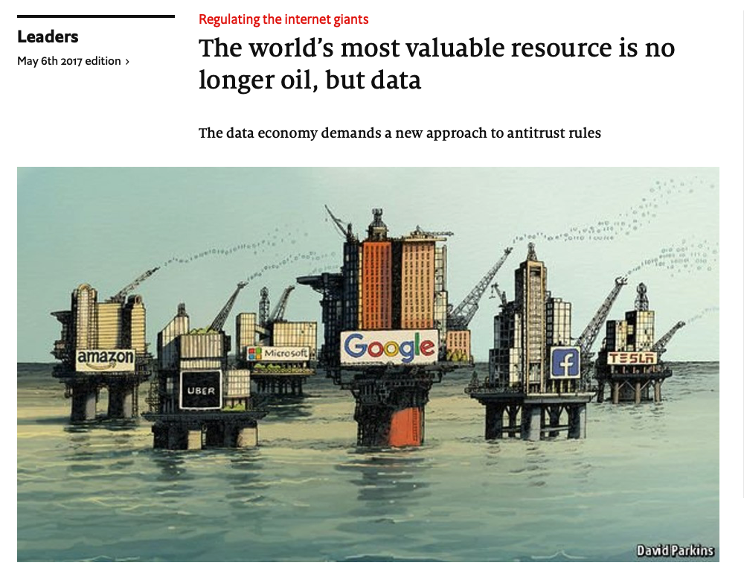
The Economist, 2017.
Notes:
Data actually has even more risks than oil. Some competing economists have debated the “data as oil” metaphor. But one stated that since data has an infinite lifespan, the risks for data gouging are even higher than for oil.

Slide 4
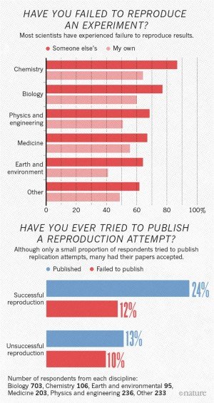
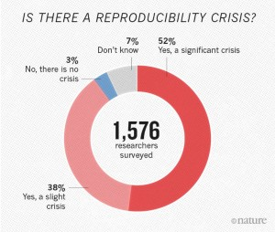
Notes:
In 2016, Nature released the results of a survey on scientific study reproducibility, in which 70% of researchers indicated they have tried and failed to reproduce another scientist’s results, and that more than half have failed to reproduce their own experiences (Baker, 2016). This “replication crisis” has shaken the field to its core. The crisis raised concerns about the validity of findings that were widely accepted as true, and helped catalyze a larger discussion about the inflated false discoveries (Munafò et al., 2017). Threats to reproducible science include selective reporting, designing quantitative studies with small samples and limited statistical power, and pressure to publish (Baker, 2016; Lui et al, 2021).

Slide 5

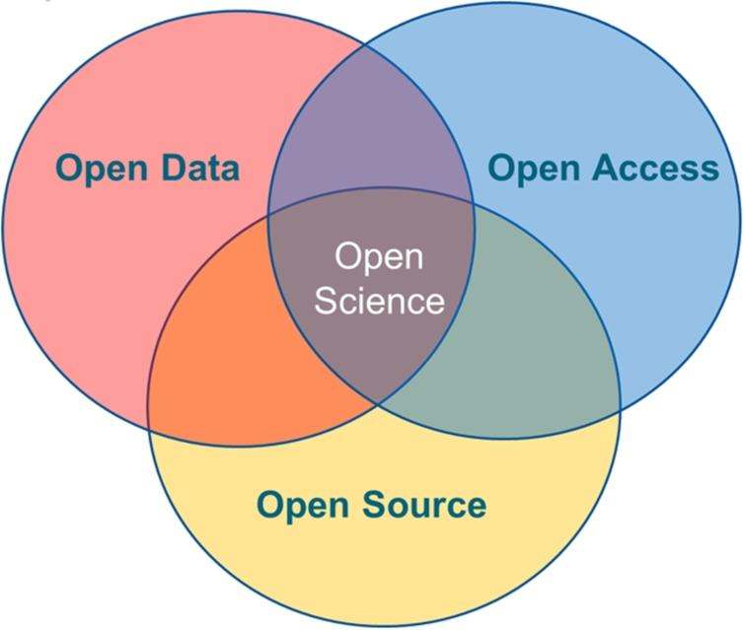
Open science is a movement to make scientific data more accessible & equitable
As data-intensive scientific discovery becomes more common, open science support the sharing, preservation, provenance, and reproducibility of data, software, and scientific workflows.
Notes:
pace of knowledge acquisition in science is frequently impeded by the difficulty researchers have in building on each other’s work.
Reproducibility and open science are closely related and share several needs in terms of both technological and software advances and changes in the expectations and culture of computational and data science.
Mainstream open science practices have been promoted as a solution to the replication crisis; the movement encourages researchers to emphasize transparency and accountability to the broad scientific community. Yet, open science practices are not widely adopted in Indigenous research, and mainstream open science does not emphasize researchers’ accountability to the communities that their science is intended to serve.

Slide 6
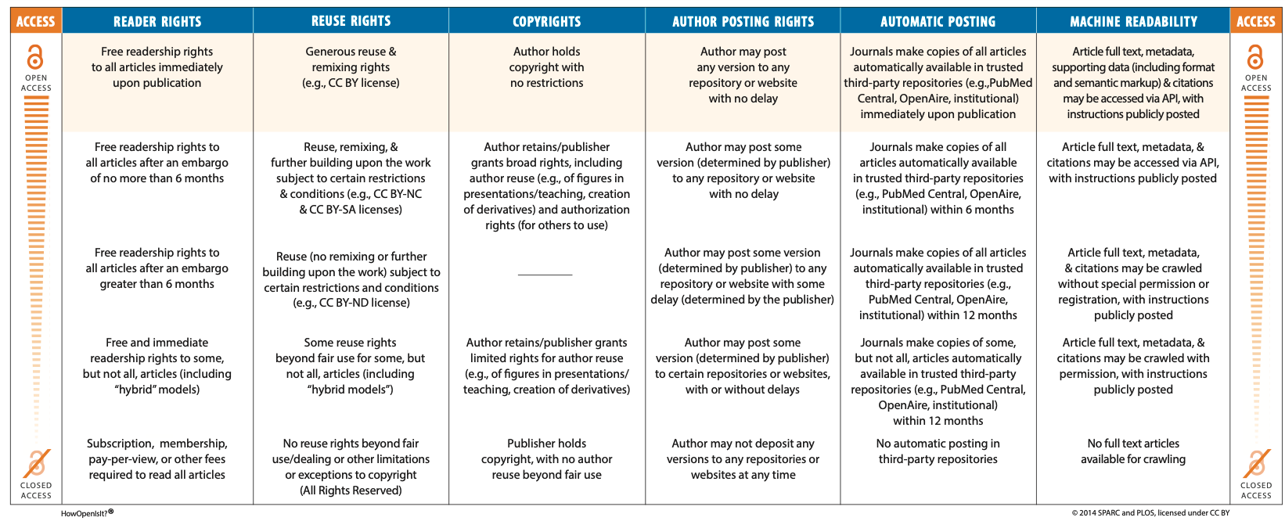
How Open is it? Open Access Spectrum
Christian Damasco et al, 2008.

Slide 7
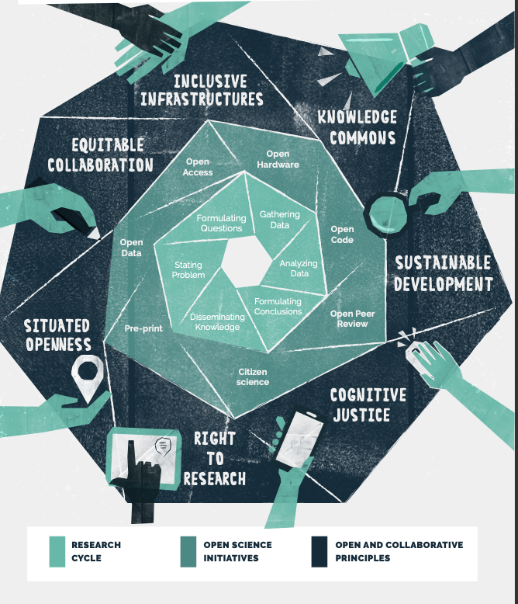
Open Collaborative Science Manifesto, 2022 (www.ocsd.net)
“We believe this is the ultimate goal: an inclusive science that not only meets the material and intellectual needs of society but that improves our well being, achieves social justice and empowers every individual to use knowledge as a pathway to the sustainable development of their communities”
Notes:
a research community composed of 12 researcher practioner teams from Latin America, Africa, MENA and Asia
highlight global inequalities in knowledge production and reaffirm the principles guiding science.
Ask important questions such as: Who participates in knowledge production processes? Whose voice counts in science? Who benefits from knowledge? How does knowledge production reproduce inequalities? In what ways can technology be used to
In what ways can technology be used to increase participation ?
increase agency in knowledge and agency in scientific production processes?

Slide 8
Information, in any format, that impacts Indigenous lives at the collective and individual levels:
WHAT ARE INDIGENOUS DATA?
DATA ABOUT OUR RESOURCES AND ENVIRONMENTS
Land information, history, geological information, titles, water information, etc.
DATA ABOUT US AS INDIVIDUALS
Demographic data, such as: administrative, legal, health and social data; commercially held data; service use data; our own data; etc.
DATA ABOUT US AS NATIONS
Traditional and cultural information, archives, oral histories, literature, ancestral knowledge, community stories, etc.
Informed by British Columbia First Nations emerging definition

Slide 9
Challenges of open science & data governance for Indigenous Peoples
Indigenous peoples and communities are largely not the legal rights holders of their data.
Who are? Universities, databases, individual researchers.
Issues of responsibility & ownership, as well as the incomplete and significant mistakes in the metadata, continue into the digital lives of this material.
Enormous amount of Indigenous data held in collections, museums, libraries, repositories, archives, repositories, and online databases.
Information about community names, provenance and data protocols are missing from collections.
With movements to increased Traditional Ecological Knowledge in STEM, there are more researchers working and collecting data and samples from Indigenous communities than ever before, generating vast amounts of new data.
What are the data responsibilities of these researchers? Of community experts?
Notes:
Currently, the vast majority of Indigenous data ranging from ethnographic material to biological materials to earth observations are not accessible to Indigenous communities to govern. Indigenous collections and data can be hard to find. They can be buried in a larger collections, datasets, repositories, or researcher possessions. Indigenous data are often mislabeled, do not indicate the Indigenous Peoples who are related to those data, and are not searchable.
Importantly,Indigenous Peoples largely are not the legal rightsholders. Thus, Indigenous collections and data do not perpetuate Indigenous provenance, protocols for use and sharing, or permissions across the digital lifespan..
Examples like SEIUnet (for plant samples), NEON, museum samples

Slide 10
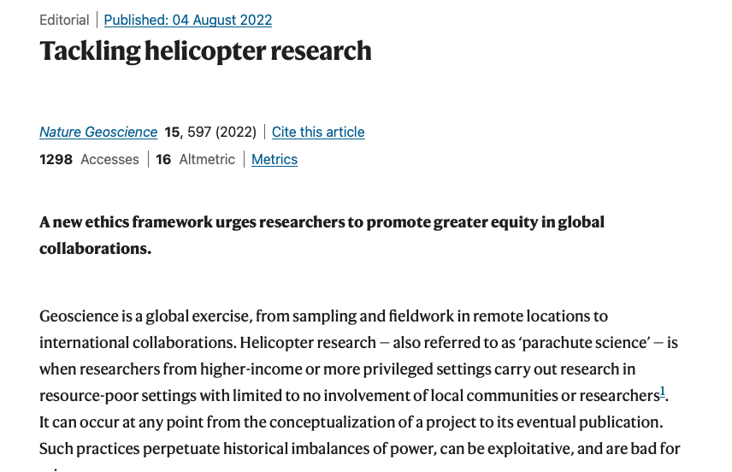
Helicopter Science
When researchers from wealthier countries go into a developing county to collect information or samples.
Lack meaningful collaboration with local infrastructure, communities and experts.

Slide 11
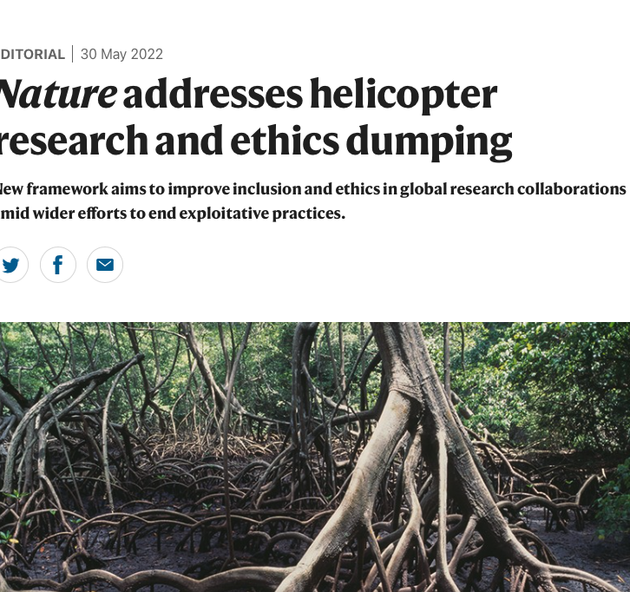
Ethics Dumping
The export of unethical research practices from higher-income to lower-income/Global North-Global South settings.
Can occur intentionally
Researchers knowingly side-step restrictive regulatory regimes to undertake research abroad that would be prohibited in their home setting.
Can occur unintentionally
Researchers lack the knowledge or ethics awareness to undertake studies appropriately in unfamiliar settings.

Slide 12
Can you think of examples of Ethics Dumping or Helicopter Science in your research/field?

Slide 13
A few examples…
Culturally inappropriate conduct of researchers
“Researchers took photographs of individuals in their homes, of breastfeeding mothers, or of underage children, whilst ignoring our social customs and norms. Bribes or other advantages were offered”.
Undertaking research without ethics approval
Failure to obtain ethical approval for research in Nepal or effort to obtain retrospective ethical approval in Liberia when the publication of research results was otherwise blocked.
Imposing burdens and risks on research participants who are unlikely to benefit themselves
Ebola virus research undertaken in a resource-poor setting that had no incidence of Ebola, and amongst vulnerable populations who were unlikely to obtain access to the resulting products and services.
Exporting valuable materials abroad without benefit sharing
Refusal by an overseas company conducting a Chinese clinical trial to pay financial compensation for harm incurred as a result of taking part in medical research.

Slide 14
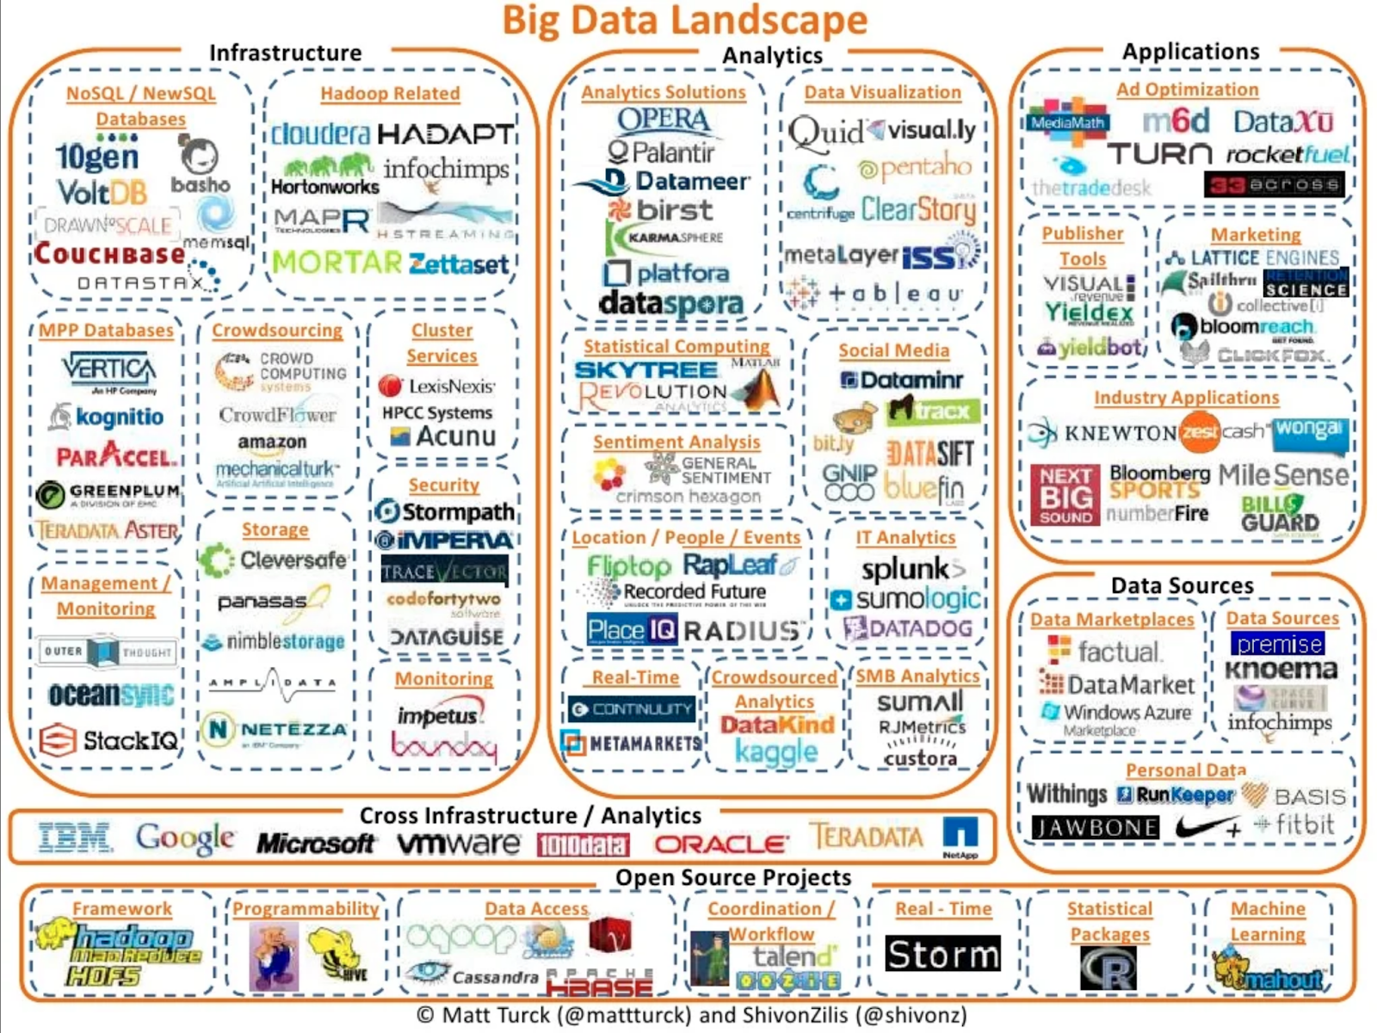
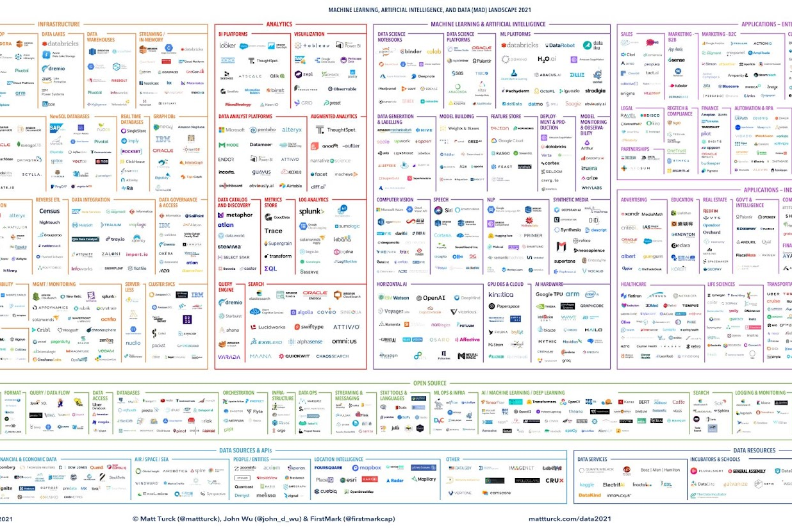
Big Data Landscape
2012
2021
Where are data ethics and responsibility within this development of programs in the big data landscape?
Figures by Matthew Turck & Shivon Zillis (@mattturek & @shivonz)
Notes:
Every year, these figures by Matthew Turck & Shivon Zillis are made, assessing the progrms wthin the big data landscape. What is important here is that the # of programs to process data, to mine data and to house data have tripled in the last 9 years, but what about our data ethics in this big data landscape? Where are the perspectives and input of the communities most impacted? Where are the spaces for sovereignt nationsor those that don’t have internet access to assert their authority?

Slide 15
MAINSTREAM DATA SOVEREIGNTY & DATA GOVERNANCE
+
DATA SOVEREIGNTY:
the concept that information which has been converted and stored in binary digital form is subject to the laws of the country in which it is located. Geographically bound.
DATA GOVERNANCE:
refers to the ownership, collection, control, analysis, and use of data.
+
(Rouse M, 2013; http://whatis.techtarget.com/definition/data-sovereignty)
(The Data Governance Institute, 2015; http://www.datagovernance.com/adg_data_governance_definition/)
Notes:
– Geographically bound, digital information
– Corporate ownership of data, like facebook
IDSov (expands beyond digital and geography to allow persistent relationships across time and space) and Gov (in mainstream from corporate roots) change these

Slide 16
Indigenous Data Sovereignty
STEMS FROM TRIBAL SOVEREIGNTY POSITIONED WITHIN:
Federal & State Recognition
Court Cases
Treaties
International Policy
Notes:
Indigenous Data Sovereignty (IDSov) focuses on the protection of Indigenous Peoples’ rights and interests in the governance of their data [1]. Protected data include information (collected by any entity, Indigenous or otherwise) about Indigenous Peoples’ physical environments and non-human relations, individuals and communities, and oral histories, languages, and belongings [2,3,4]. Indigenous data interests span diverse fields including human health, genomics, environmental sciences, social sciences, data sciences, the humanities, and cultural heritage. Across these sectors, the demand for policies, practices, and tools to reconcile community data governance with institutional and researcher responsibilities is increasing.
hese rights are supported by the United Nations Declation on the Rights of Indigneous Peoples and have been endorsed by the Special Rapporteour on the right to privacy

Slide 17
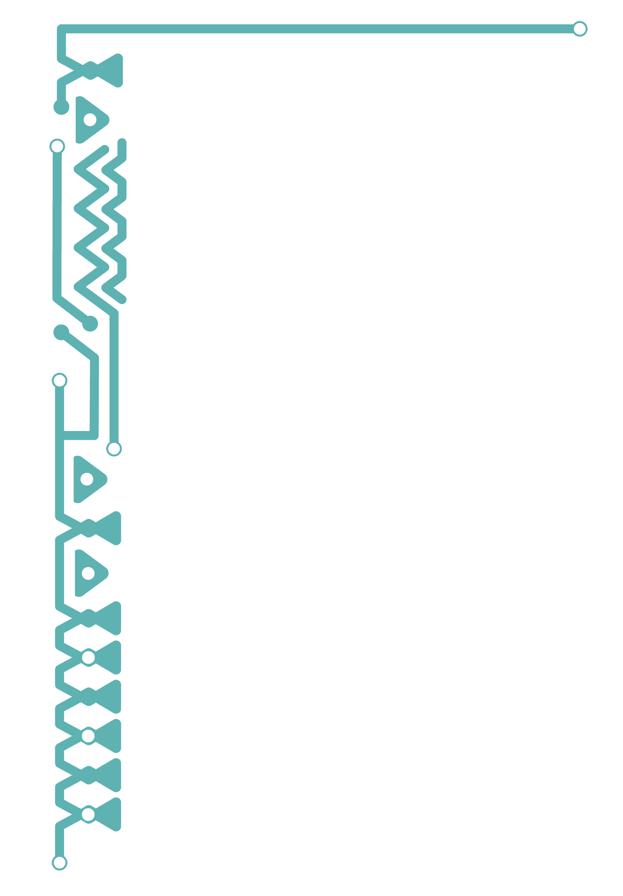
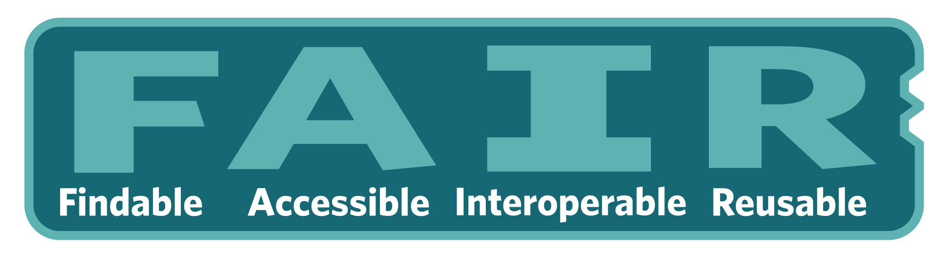
Wilkinson, M. D. et al. The FAIR Guiding Principles for scientific data management and stewardship. Sci. Data 3:160018 doi: 10.1038/sdata.2016.18 (2016).
Notes:
Most scientensts today are trained in the Fair characteristic of data.
. The FAIR principles seek to increase data sharing and reproducibility.

Slide 18
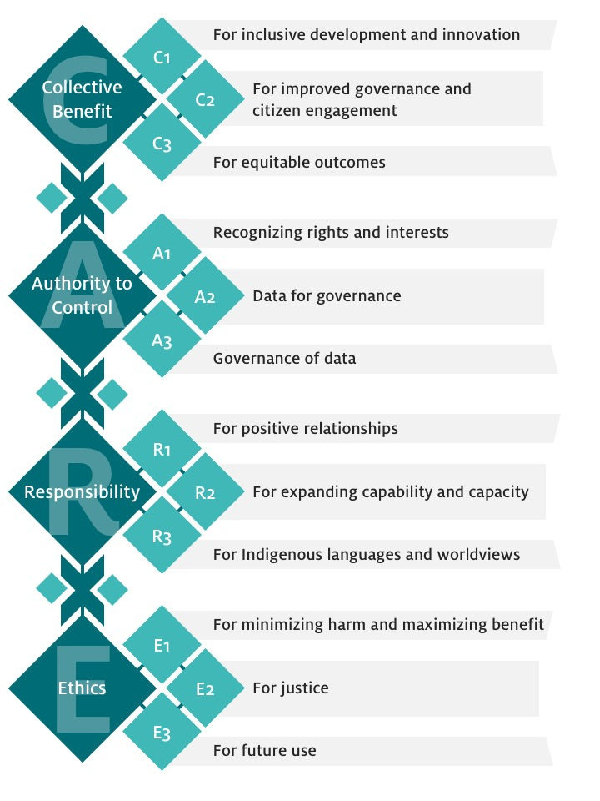
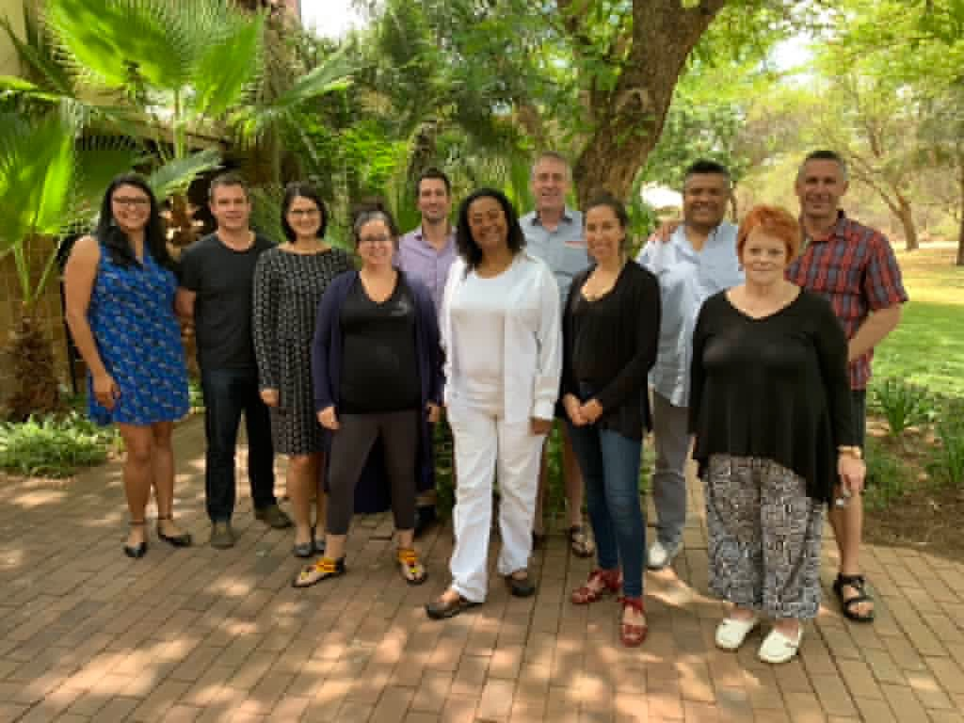
CARE Principles for
Indigenous Data Governance
Carroll, SC, Garba, I, Figueroa-Rodríguez, OL, Holbrook, J, Lovett, R, Materechera, S, Parsons, M, Raseroka, K, Rodriguez-Lonebear, D, Rowe, R, Sara, R, Walker, JD, Anderson, J and Hudson, M. 2020. The CARE Principles for Indigenous Data Governance. Data Science Journal, 19: 43, pp. 1–12. DOI: https://doi.org/10.5334/dsj-2020-043
Notes:
In response to the increased generation and use of data in open data, big data, open science, and research environments and limited opportunities for Indigenous control, the CARE Principles for Indigenous Data Governance have been drafted. In 2019, The Global Indigenous Data Alliance released the CARE Principles which are—Collective benefit, Authority to control, Responsibility and Ethics. These CARE principles set forth critical considerations for non-tribal data creators, stewards, and users and are designed to guide the inclusion of Indigenous Peoples in data governance, increase Indigenous communities access to data and decrease digical colonization. The CARE Principles shift the focus of data governance from consultation to values-based relationships, and have been widely recognized as enriching the discussion of collective rights to data for other populations as well.

Slide 19
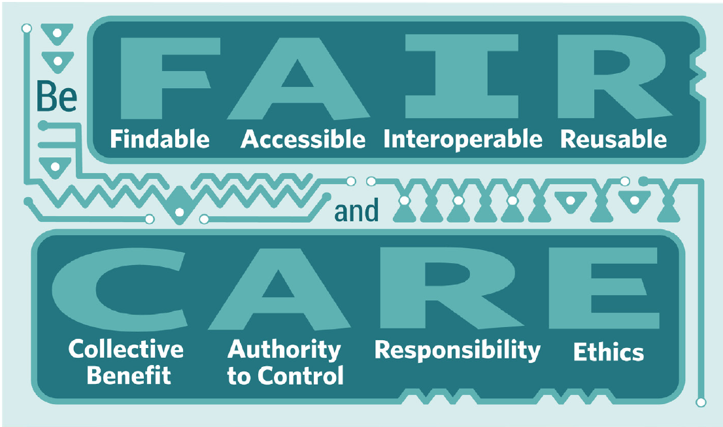
Seek to increase data sharing
Critical considerations for non-tribal data creators, stewards, and users
Russo-Carroll et al., 2021
Notes:
Many who work in data science are being trained in the FAIR pinciples
FAIR principles which are Findable, Accessible, Interoperable, and Reusable. The FAIR principles seek to increase data sharing.
In response to the increased generation and use of data in open data, big data, open science, and research environments and limited opportunities for Indigenous control, the CARE Principles for Indigenous Data Governance have been drafted. In 2019, The Global Indigenous Data Alliance released the CARE Principles which are—Collective benefit, Authority to control, Responsibility and Ethics. These CARE principles set forth critical considerations for non-tribal data creators, stewards, and users and are designed to guide the inclusion of Indigenous Peoples in data governance, increase Indigenous communities access to data and decrease digical colonization. The CARE Principles shift the focus of data governance from consultation to values-based relationships, and have been widely recognized as enriching the discussion of collective rights to data for other populations as well.
The CARE principles bring a people-and-purpose orientation to data governance, which complements the data-centric nature of the popular FAIR principles which are Findable, Accessible, Interoperable, and Reusable. The FAIR principles seek to increase data sharing. Implementation of the CARE and FAIR Principles together should be seen as necessary to allow Indigenous Peoples to govern, access, and use their data, and to share on their own terms.
Have to do both!
Fair is about attibtues of data, such as Provence and machine actionability- to make meta data findable, accessible, I, R,
These are important to not only Indigenous scientsits, but to all scienctists who seek to make more ethically and community accessible science.

Slide 20
RIGHTSHOLDERS
AND STAKEHOLDERS
INDIGENOUS DATA SOVEREIGNTY >> RELATIONSHIPS FOR INDIGENOUS DATA GOVERNANCE
Data Repositories
Publishers
Researchers
FEDERALLY RECOGNIZED - STATE RECOGNIZED
NON-RECOGNIZED
Universities
Granting Entities
Other Governments
Notes:
All these entities need to change their practices and align with Indigenous expectations of data
What are the resposnibilites of data repositores

Slide 21
Institutional Responsibilities for Indigenous Data Governance
Center CARE principles in the development of
data policy & platforms
Enrich metadata (provenance, permissions, attribution & protocols)
Protect both personal and community identifiable information
Formalize voluntary guidelines
Slide developed by Talia Anderson, PhD Student
School of Geography, Development and Environment
University of Arizona
Notes:
I highlight some key responsibilities and recommendations for enhancing data governance practices and for incorporating more equitable and just frameworks into data policies and practices.
All of the responsibilities and recommendations we identify in this presentation are centered around the broader theme of building the CARE principles into the development of data policy and platforms. A few ways in which we’ll talk about that specifically are by: …. CLICK for recs

Slide 22
Where can Indigenous Data Governance be put into practice?
Law, e.g., Common Rule, UNDRIP, tribal​
Policy, e.g., government, institutional, org, professional guidelines ​
Ethics, e.g., training, metadata labels​
Infrastructures, e.g., data standards, programming innovations
Notes:
Concerns about implemting in already existing data
Institute poliies and practices that is currently being created is also ethical

Slide 23

Enriching metadata
Traditional Knowledge Labels
Biocultural
Labels
https://localcontexts.org/
Notices
Slide developed by Talia Anderson, PhD Student
School of Geography, Development and Environment
University of Arizona
Notes:
One way enriching metadata can be put into action is through the use of Traditional Knowledge Labels, Biocultural Labels, and Notices from Local Contexts Hub. The Local context labels and notices were developed in partnership with Indigenous communities globally to enhance Indigenous data governance and to establish the conditions for the sharing and reuse of Indigenous knowledge and intellectual property in digital spaces.

Slide 24

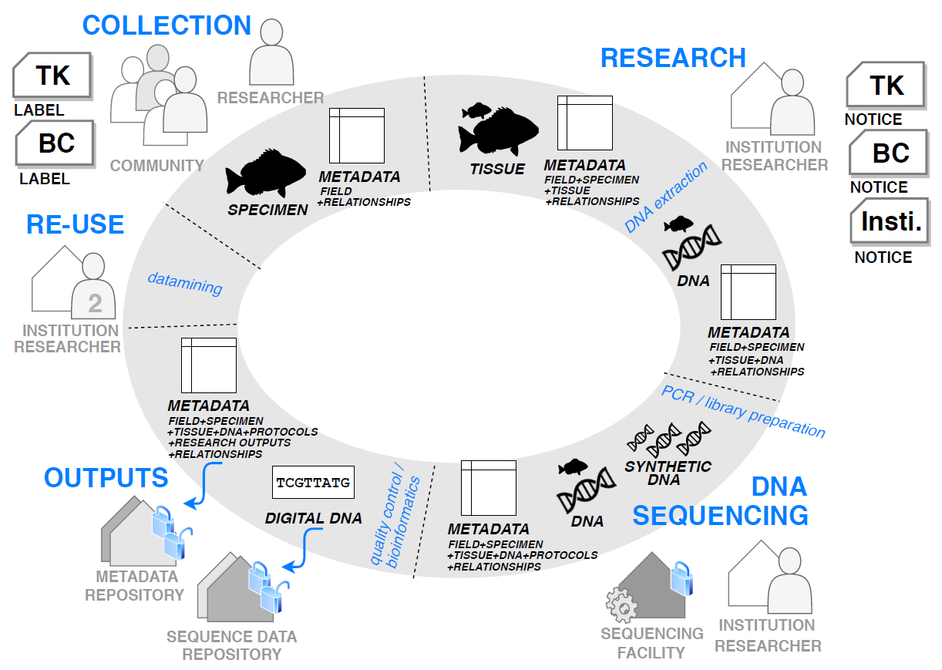
THE DATA LIFE CYCLE
Labels
Notices
Adapted from L.Liggins@massey.ac.nz www.massey.ac.nz/iramoana
Notes:
Creating law, policy, ethics, and infrastructure the support Indigenous rights to Indigenous data throughout the data lifecycle and across the data ecosystem, and to strengthen such rights by making changes, even minimal at first, across data actors such as research institutions, repositories, publishers, funders, and more. Next I will highlight a few brief examples.
As we move into discussing some of the institutional and organizational responsibilities and recommendations in relation to Indigenous data, it is important acknowledge that there is no one size fits all approach.

Slide 25
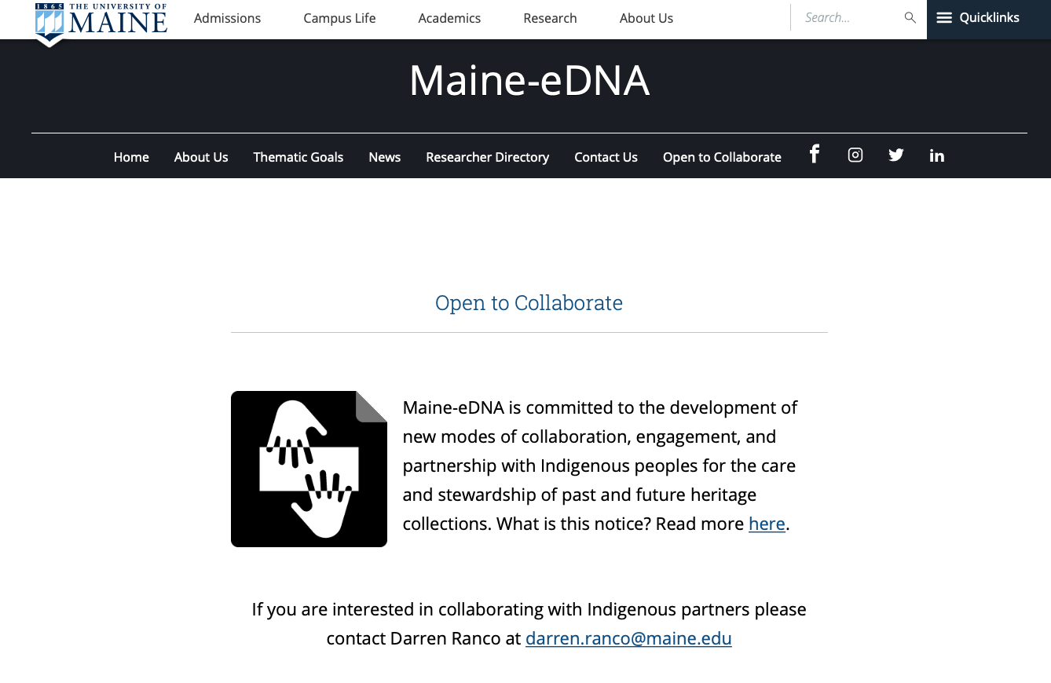

Slide 26
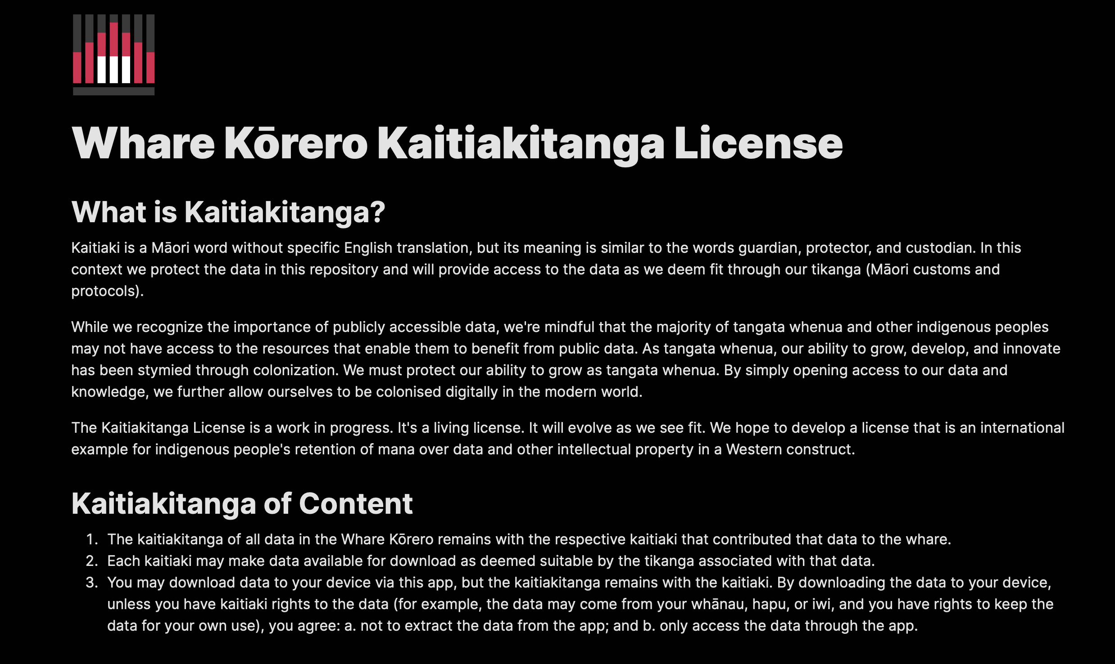
Notes:
kaitiaki licence in github; Indigenous patent lawyers of each community determine this, paid license with tribal entity.
A smart contract is useful because it survives the person crawing up.
Instutionalize so that
Tehiku media

Slide 27

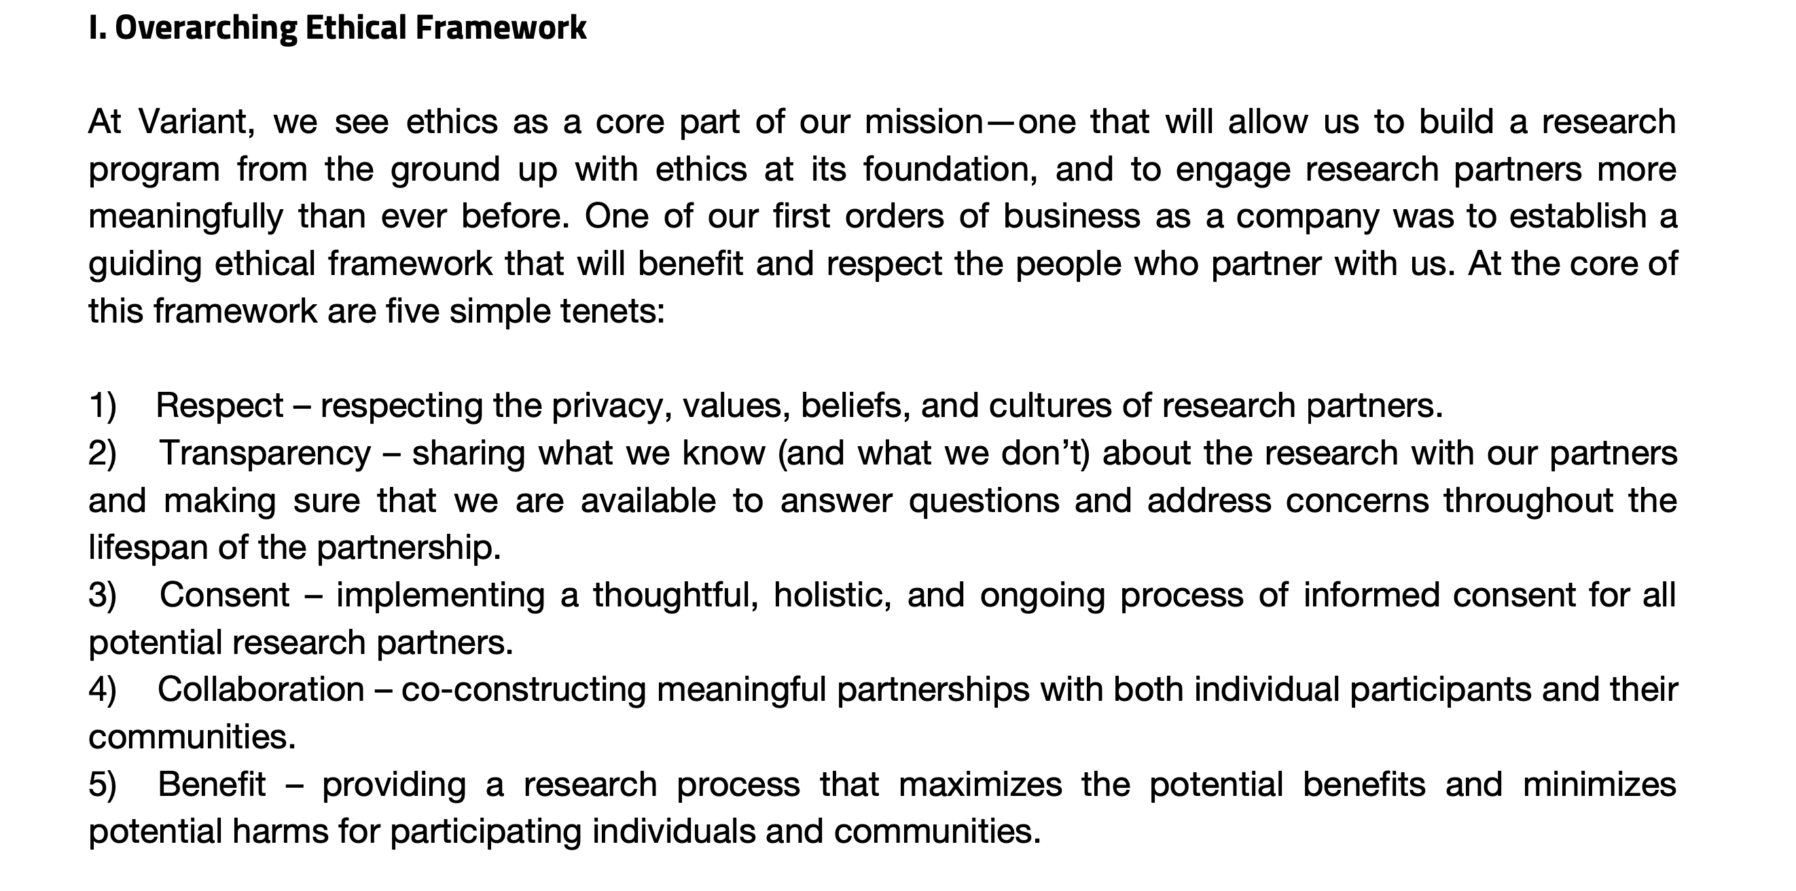
Notes:
Ethics Statement from Variant Bio
Within the statement they outline overarching ethical framework, key principles for community and individual engagement and co-creation, specific guidelines for working with biobanks, and the process by which they ensure that studies meet ethical standards, and their t=ethics advisory board

Slide 28
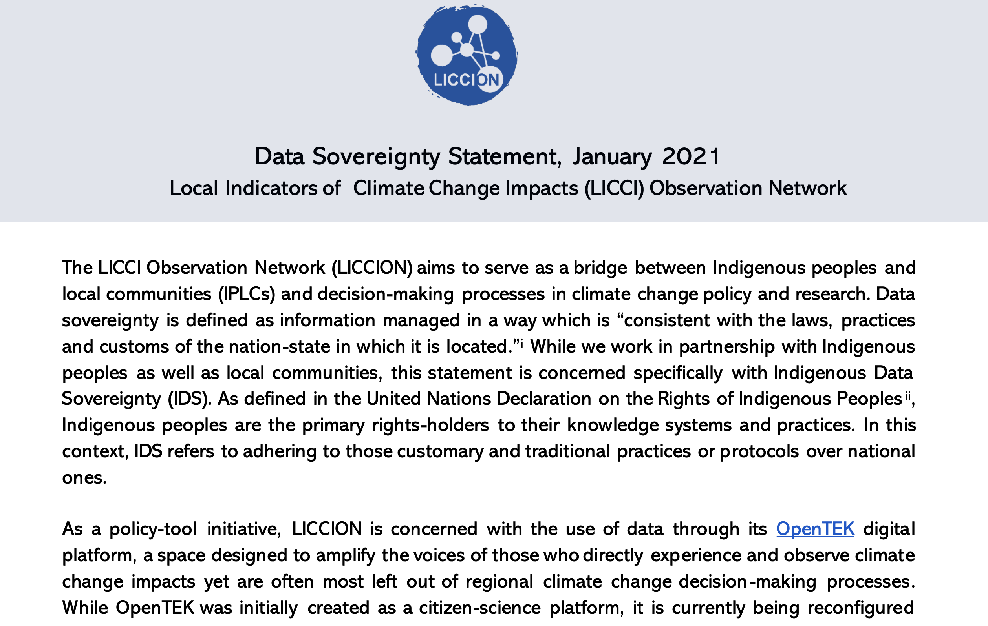
Open TEK- Data Sov statement
Notes:
Open TEK Data Sovereignty Statement
Recognized that while OpenTEK was initially created as a citizen-science platform, it is currently being reconfigured to meet the demands of LICCION partners, and specifically meet the diverse and context-specific requirements and values of IPLCs globally. LICCION is in the process of creating an Advisory Group which will be able to steer our direction and guide our decision-making regarding data, information, and knowledge broadly speaking.
The following initiatives serve as our guiding frameworks: 1) CARE; 2) OCAP®; 3) TK & BC Labels; 4) Te Mana Raruanga Charter. While some of these initiatives are context-specific (i.e., Te Mana Raruanga, OCAP®), they offer implementation ideas for common core principles. These essential principles call for, among others, a) Indigenous ownership of knowledge and its relationship to uses; b) Indigenous authority to control and access; c) prioritizing collective benefit over individual benefit; d) recognition of context-specificity; e) a values-based approach which goes beyond the consultation process; and f) consideration for future use and generations.

Slide 29
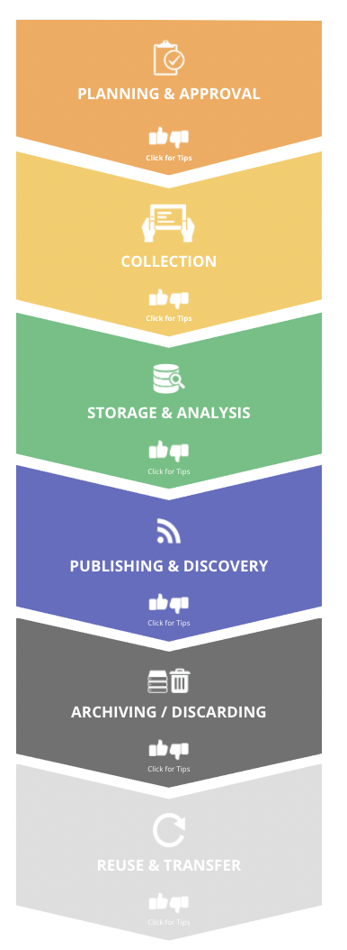
Track data use and reuse
CGIAR Guidelines for the
Data Cycle
Slide developed by Talia Anderson, PhD Student
School of Geography, Development and Environment
University of Arizona
Notes:
The final recommendation I want to make today surrounds research reporting and compliance as it relates to tracking the use and reuse of Indigenous data. Since repositories often “measure, assess, and track research outputs” as part of open access, tracking could include creating a mechanism that identifies who and how data are accessed and used. With this type of tracking, it is possible to determine if future data uses are consistent with community values and protocols.
This is critical to mitigate harm since data used by third parties is even further removed from its local context. And while appropriate permissions to reuse won’t be able to be fully recognized until something like the TK or BC labels are included or until repositories facilitate community permissions to data use and reuse, tracking the reuse of data is a first step in identifying how data is being used in ways that do or do not align with community values and protocols. Examples of this in practice involve data-access review committees who evaluate whether a project aligns with informed prior consent prior before granting data access (Hudson et al., 2020) – ideally these would be Indigenous-led.

Slide 30
Thinking forward: Future of Indigenous Data Ethics
We’ve Discussed…
On the horizon…
Traditional Knowledge labels
Ethics Statements
Data Sovereignty Statements
Defining Indigenous Data
Intellectual Property Policies
Policy & Guidelines phases
Notes:
Talked about:
Traditional Knowledge Labels, ethics statements, and data sovereignty statements. No current enforcement and bring up a lot of reflection with partneninf agencies
On the horizon (and more complicated)
Varied histories with scientists can complicate these next steps on the horizon, such as assigning responsibilities. We must create change at multiple levels, and have a broad strategy that all must be responsible for that engage with Indigenous peoples and datas
Partner organizations must begin creating a set of guidleines to their repositiories that incudle the FAIR & CARE guidelines

Slide 31
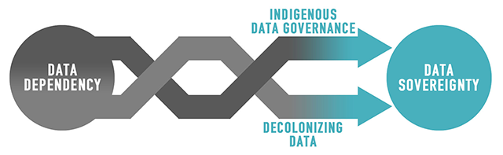
Our Goal: Move from Data Wardship to Data Sovereignty, Driven by Community Expertise
Notes:
My work, and those of my fellow Indignous collegues, is working to move from data wardship to data governance, by advance data stewardship competency, repository policies, and repository practices to improve FAIR with CARE data approaches.

Slide 32
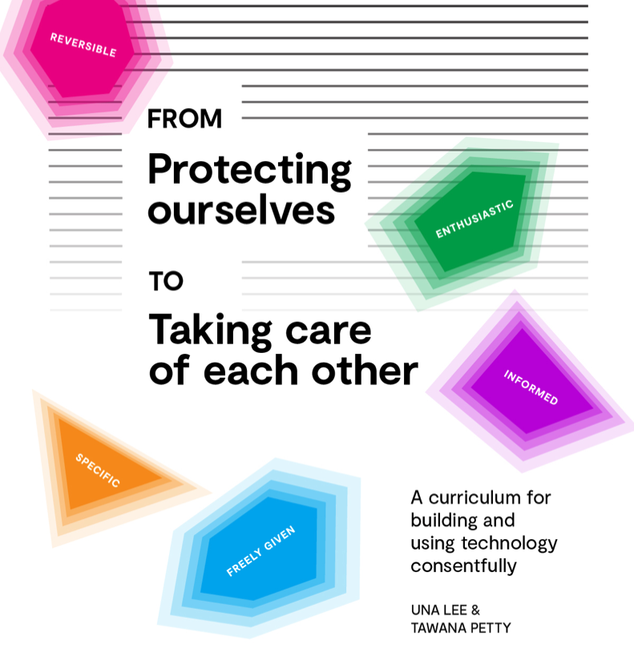
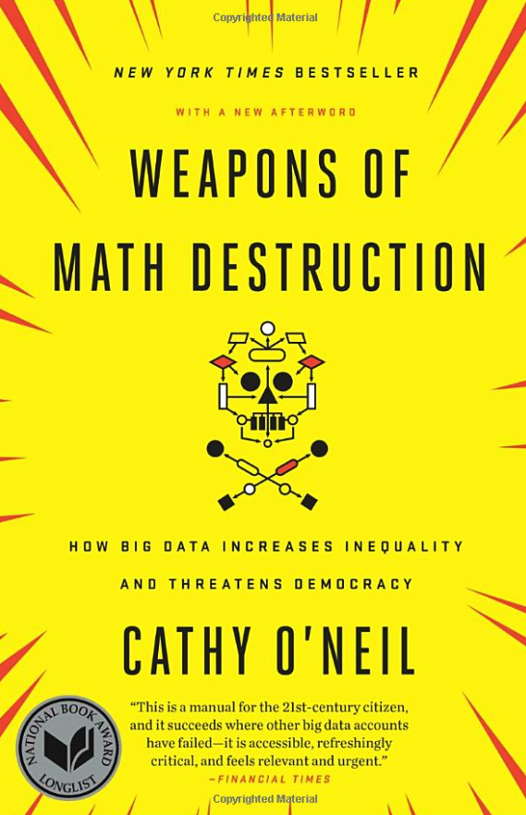
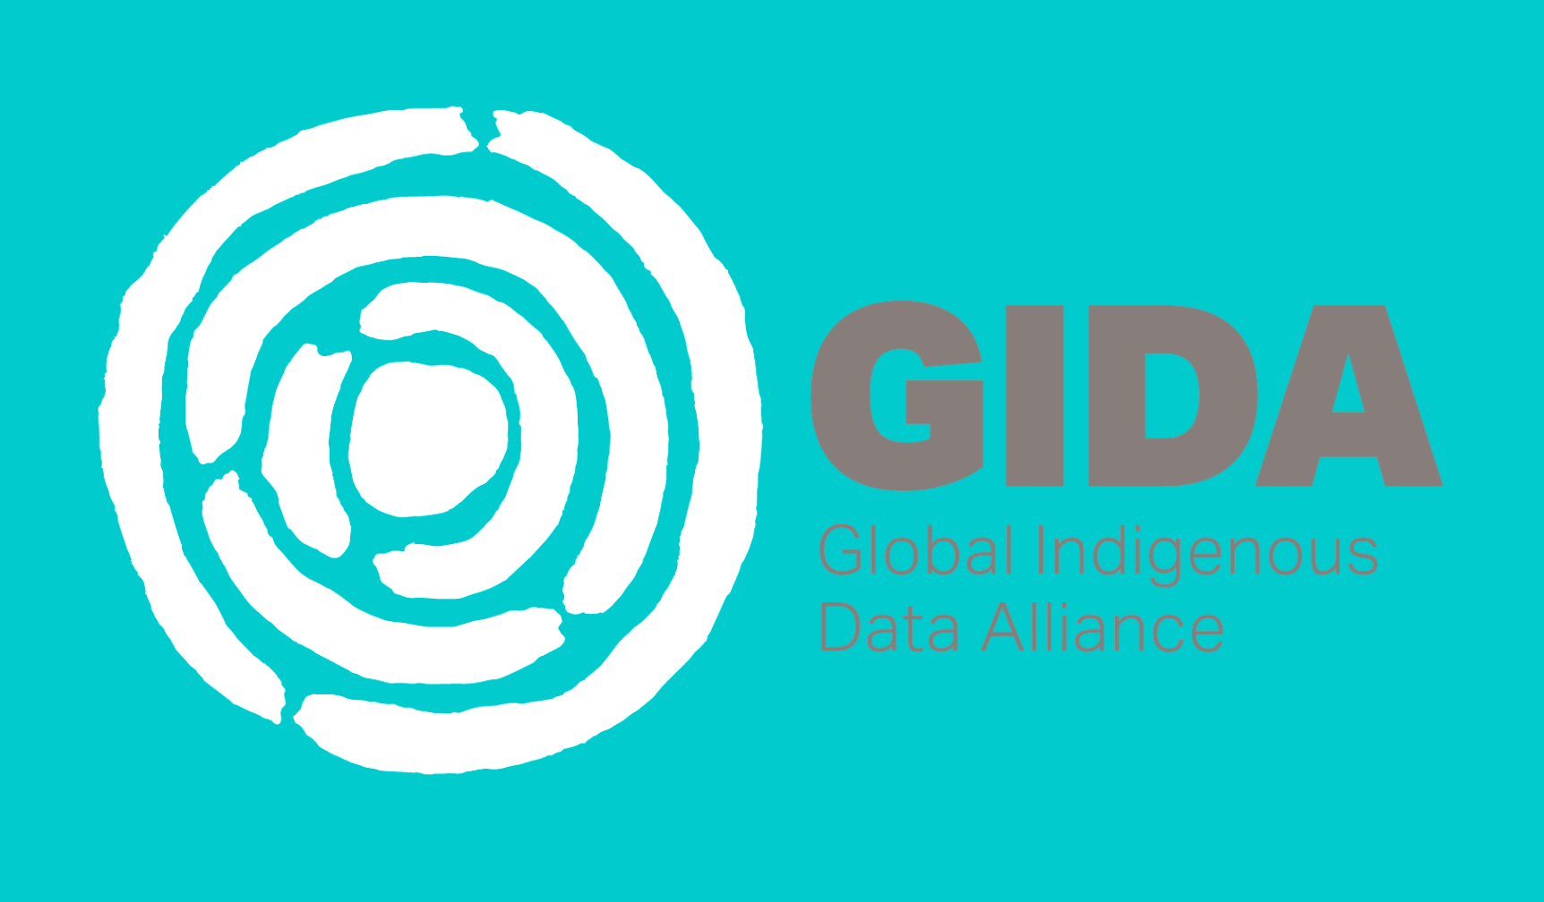

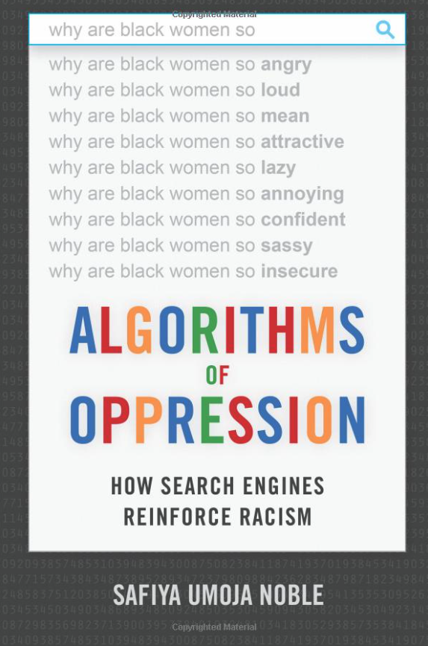
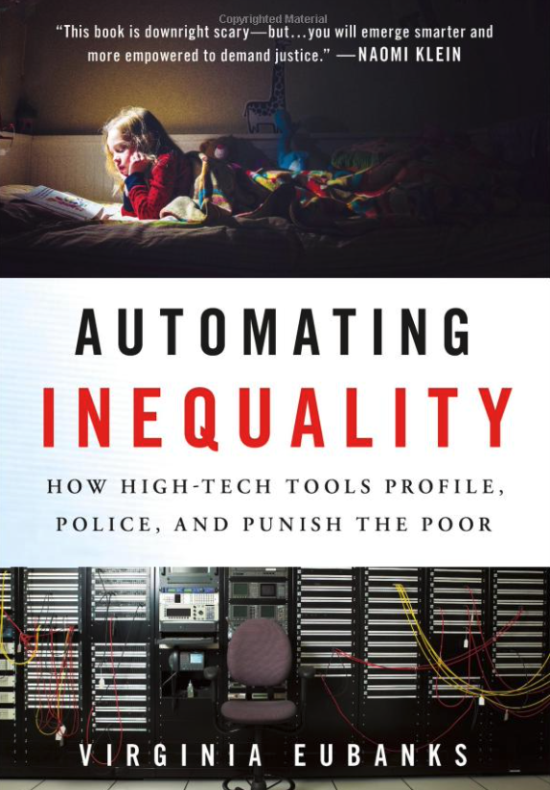
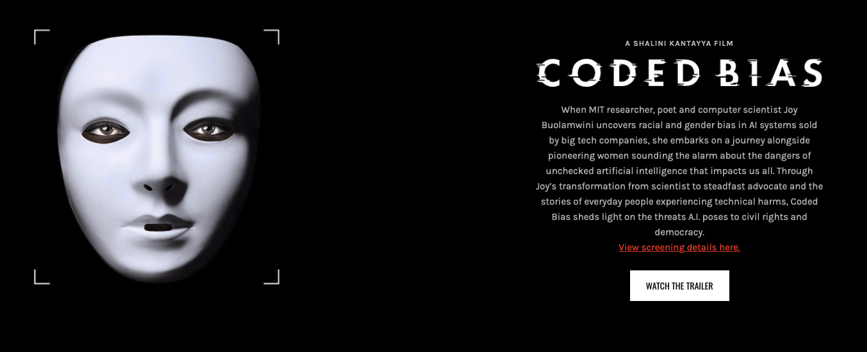
Other resources to think about data ethics & justice
The Algorithmic Justice League
Notes:
So, today I’ve discussed a lot about the ethics of data for Indigenous communities, which is both because this is the community to which I belong and because of our political status as sovereignty nations and specific rights holders of our data ( as outlined by the UNDRIP, federal recongintion, and US inidian law, etc). However, much of this work has applications to other magniiziliaed communities within and outside of the US. Here are a few examples of groups doing important data ethics and justice work within the data science realms.

Slide 33
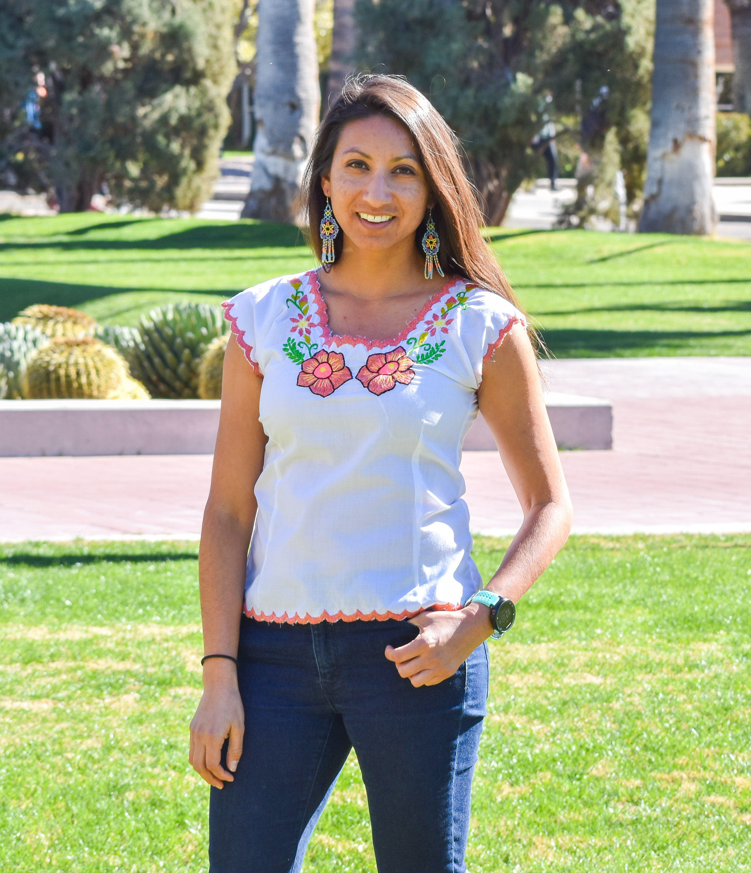

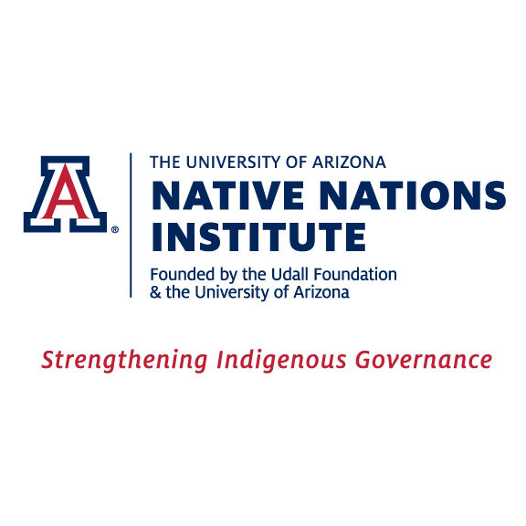
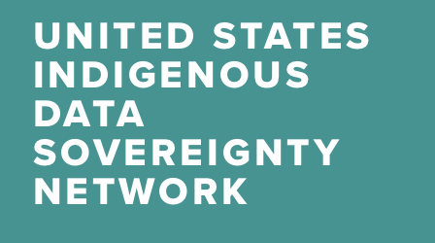
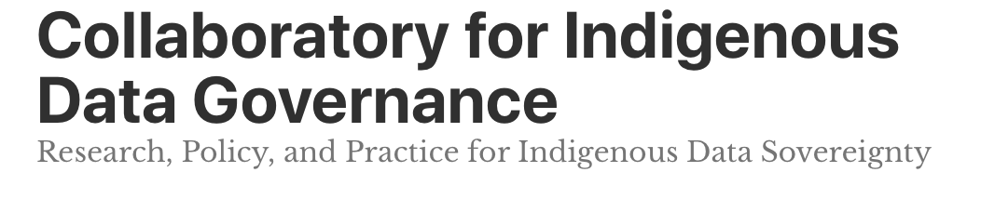
Lios emak aane
Questions?
@UAZPublicHealth
Email: lljennings@email.arizona.edu
Twitter: @1NativeSoilNerd
@NNIarizona
@USIndDataSov
@IndigiDataLab
@GidaGlobal

